Slide 1

Database Processing: Fundamentals, Design, and Implementation
15th Edition
Week #3
Part 1B
Introduction to Structured Query Language

Slide 2
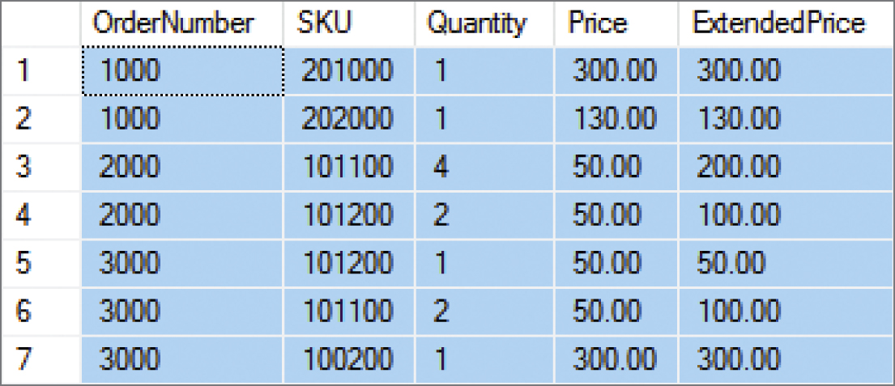
Sorting the SQL Query Results I The SQL ORDER BY Clause
SELECT *
FROM ORDER_ITEM
ORDER BY OrderNumber;

Slide 3
Sorting the SQL Query Results II Ascending and Descending Sort Order
SELECT *
FROM ORDER_ITEM
ORDER BY Price DESC, OrderNumber ASC;

Slide 4
SQL Logical Operators
SQL Logical Operators
Operator | Meaning
AND | Both conditions are TRUE
OR | One of the other or both conditions are TRUE
NOT | Negates the associated condition

Slide 5
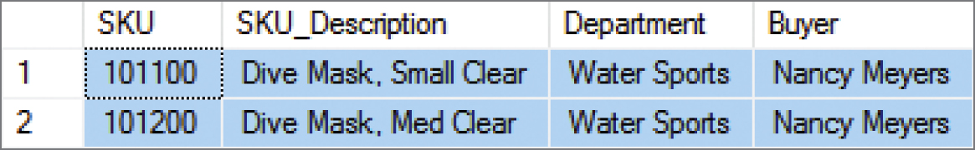
SQL WHERE Clause Options II SQL AND Operator
SELECT *
FROM SKU_DATA
WHERE Department='Water Sports’
AND Buyer='Nancy Meyers';

Slide 6
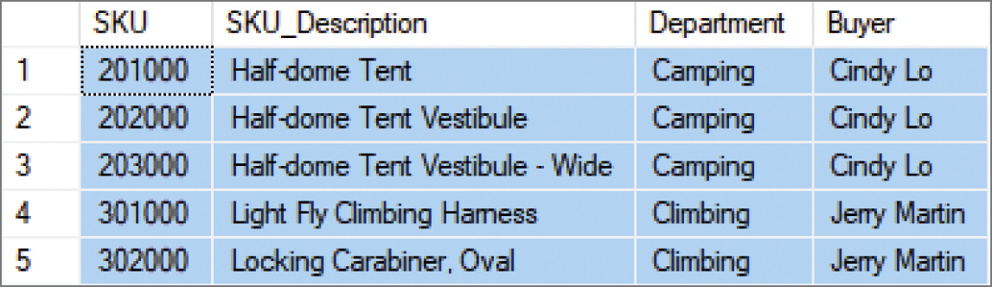
SQL WHERE Clause Options III SQL OR Operator
SELECT *
FROM SKU_DATA
WHERE Department='Camping’
OR Department='Climbing';

Slide 7
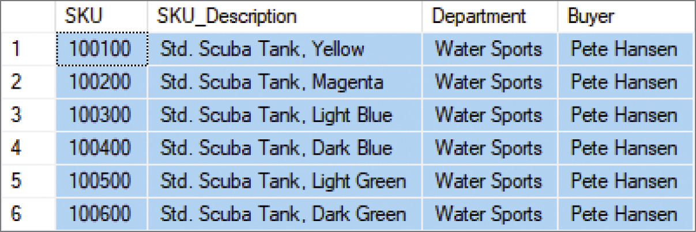
SQL WHERE Clause Options IV SQL NOT Operator
SELECT *
FROM SKU_DATA
WHERE Department='Water Sports’
AND NOT Buyer='Nancy Meyers';

Slide 8
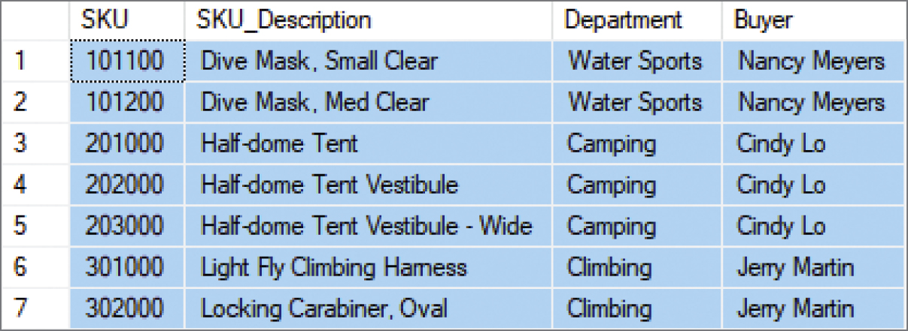
SQL WHERE Clause Options V Sets of Values: SQL IN Operator
SELECT *
FROM SKU_DATA
WHERE Buyer IN ('Nancy Meyers', 'Cindy Lo', 'Jerry Martin');

Slide 9
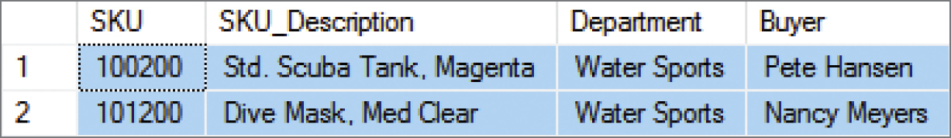
SQL WHERE Clause Options VI Sets of Values: SQL NOT IN Operator
SELECT *
FROM SKU_DATA
WHERE Buyer NOT IN ('Nancy Meyers', 'Cindy Lo', 'Jerry Martin');

Slide 10
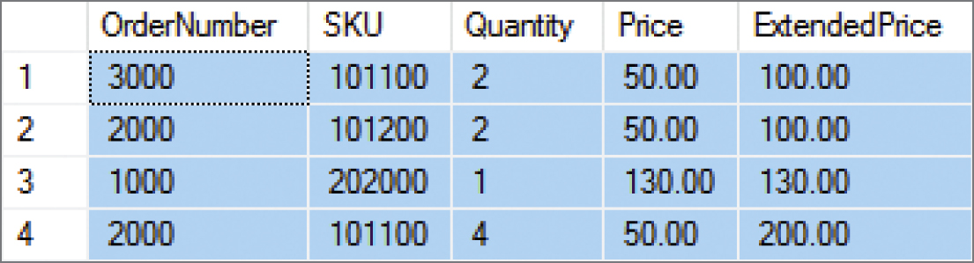
SQL WHERE Clause Options VII Ranges of Values: Using Math Symbols
SELECT *
FROM ORDER_ITEM
WHERE ExtendedPrice >= 100
AND ExtendedPrice <= 200
ORDER BY ExtendedPrice;

Slide 11
SQL WHERE Clause Options VIII Ranges of Values: SQL BETWEEN Operator
SELECT *
FROM ORDER_ITEM
WHERE ExtendedPrice BETWEEN 100 AND 200 ORDER BY ExtendedPrice;

Slide 12
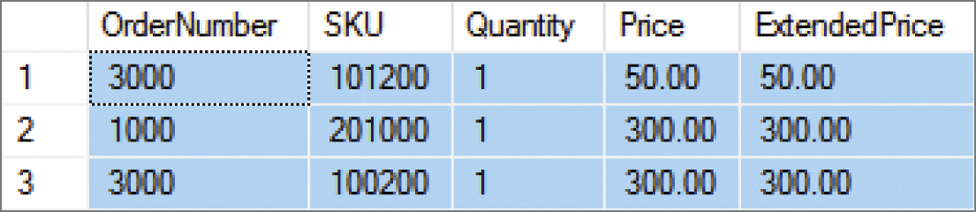
SQL WHERE Clause Options IX Ranges of Values: SQL NOT BETWEEN Operator
SELECT *
FROM ORDER_ITEM
WHERE ExtendedPrice NOT BETWEEN 100 AND 200
ORDER BY ExtendedPrice;

Slide 13
SQL WHERE Clause Options X Character String Patterns: SQL Wildcard Characters
The SQL LIKE operator and SQL NOT LIKE operator can be combined with wildcard symbols:
the SQL underscore (_) wildcard character, which represents a single, unspecified character in a specific position in the character string
the SQL percent sign (%) wildcard character, which represents any sequence of contiguous, unspecified characters (including spaces) in a specific position in the character string

Slide 14

SQL WHERE Clause Options XI Character String Patterns: SQL Like Operator I
SELECT *
FROM SKU_DATA
WHERE Buyer LIKE 'Pete%';

Slide 15
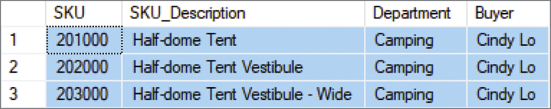
SQL WHERE Clause Options XII Character String Patterns: SQL Like Operator II
SELECT *
FROM SKU_DATA
WHERE SKU_Description LIKE '%Tent%';

Slide 16
SQL WHERE Clause Options XIII Character String Patterns: SQL Like Operator III
SELECT *
FROM SKU_DATA
WHERE SKU LIKE '%2__';

Slide 17
SQL WHERE Clause Options XIV Using NULL Values: SQL IS NULL Operator
SELECT *
FROM CATALOG_SKU_2017
WHERE CatalogPage IS NULL;

Slide 18
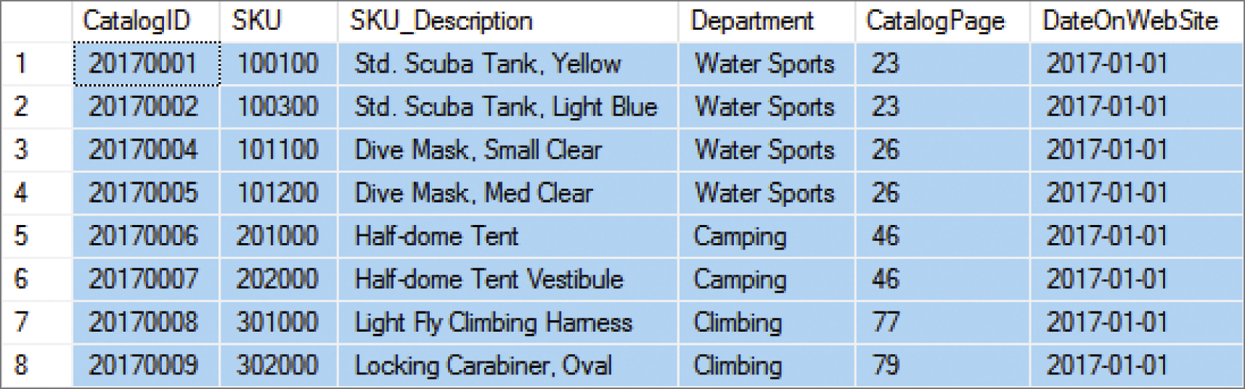
SQL WHERE Clause Options XV Using NULL Values: SQL IS NOT NULL Operator
SELECT *
FROM CATALOG_SKU_2017
WHERE CatalogPage IS NOT NULL;

Slide 19
SQL Built-in Aggregate Functions
SQL Built-in Aggregate Functions
Function | Meaning
COUNT(*) | Count the number of rows in a table
COUNT ({Name}] | Count the number of rows in the table where column {Name} IS NOT NULL
SUM | Calculate the sum of all values (numeric columns only)
AVG | Calculate the average of all values (numeric columns only)
MIN | Calculate the minimum value of all values
MAX | Calculate the maximum value of all values

Slide 20
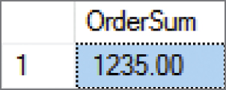
Performing Calculations in SQL Queries Using SQL Built-in Aggregate Functions: SUM
SELECT SUM(OrderTotal) AS OrderSum
FROM RETAIL_ORDER;

Slide 21
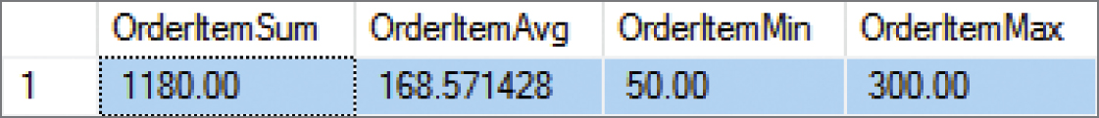
Performing Calculations in SQL Queries Using SQL Built-in Aggregate Functions: SUM, AVG, MIN AND MAX
SELECT SUM(ExtendedPrice) AS OrderItemSum,
AVG(ExtendedPrice) AS OrderItemAvg,
MIN(ExtendedPrice) AS OrderItemMin,
MAX(ExtendedPrice) AS OrderItemMax
FROM ORDER_ITEM;

Slide 22
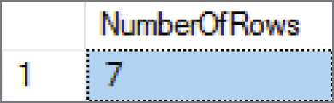
Performing Calculations in SQL Queries Using SQL Built-in Aggregate Functions: COUNT(*)
SELECT COUNT(*) AS NumberOfRows
FROM ORDER_ITEM;

Slide 23
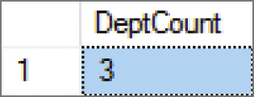
Performing Calculations in SQL Queries Using SQL Built-in Aggregate Functions: COUNT({Name})
SELECT COUNT(DISTINCT Department) AS DeptCount
FROM SKU_DATA;

Slide 24
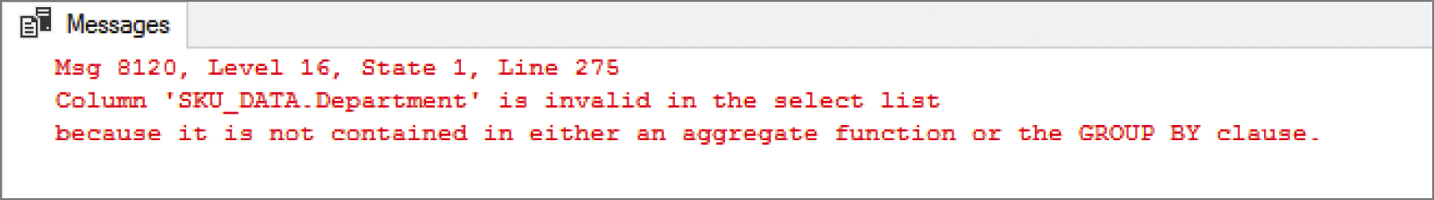
Performing Calculations in SQL Queries SQL Expressions I
You should be aware of two limitations to SQL built-in functions:
1) You cannot combine table column names with an SQL built-in function.
SELECT Department, COUNT(*)
FROM SKU_DATA;

Slide 25
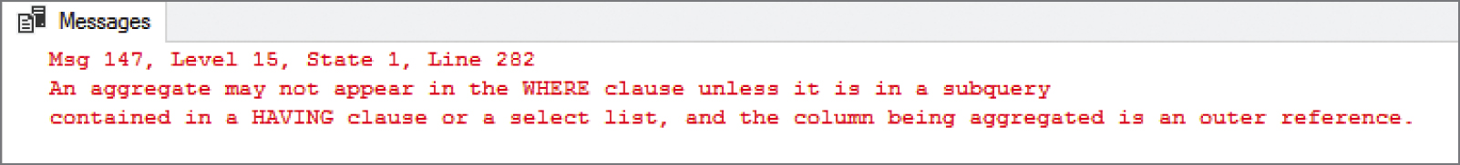
Performing Calculations in SQL Queries SQL Expressions II
2) You cannot use them (table names) in an SQL WHERE clause because the SQL WHERE clause operates on rows (choosing which rows will be displayed), whereas the aggregate functions operate on columns.
SELECT *
FROM RETAIL_ORDER
WHERE OrderTotal > AVG(OrderTotal);

Slide 26
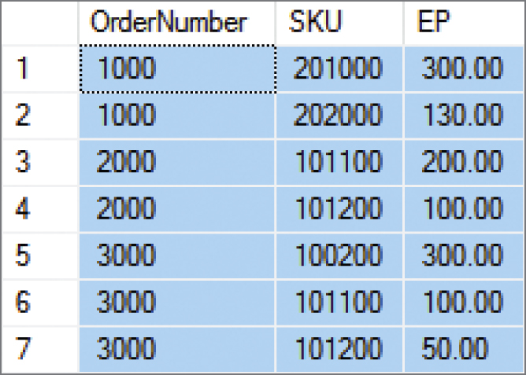
Performing Calculations in SQL Queries Using SQL Expressions I
SELECT OrderNumber, SKU, (Quantity * Price) AS EP
FROM ORDER_ITEM
ORDER BY OrderNumber, SKU;

Slide 27
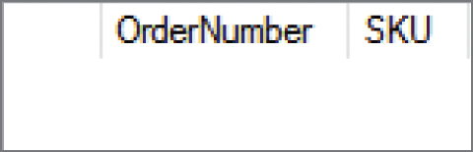
Performing Calculations in SQL Queries Using SQL Expressions II
SELECT OrderNumber, SKU
FROM ORDER_ITEM
WHERE Quantity * Price) <> ExtendedPrice
ORDER BY OrderNumber, SKU;

Slide 28
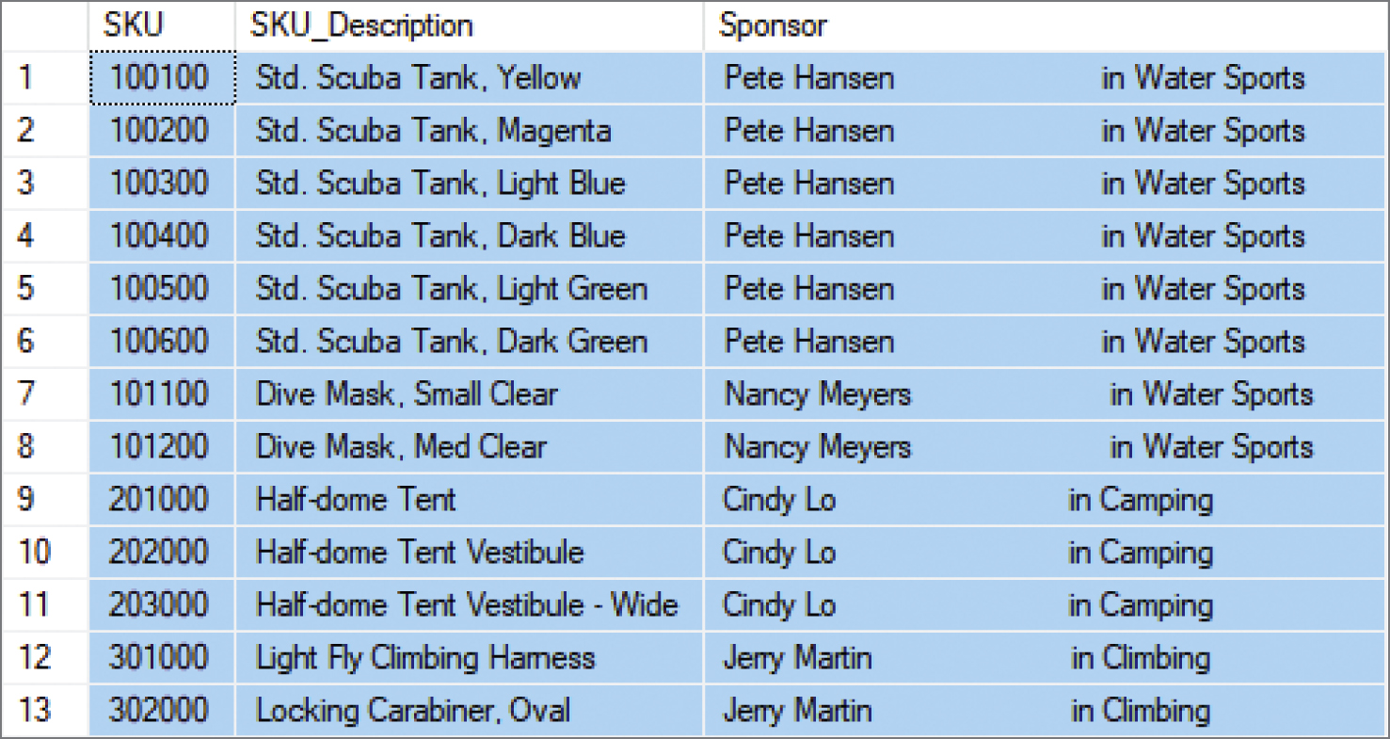
Performing Calculations in SQL Queries Using SQL Expressions with String Functions: Concatenation
SELECT SKU, SKU_Description, (Buyer+' in '+Department) AS Sponsor
FROM SKU_DATA
ORDER BY SKU;

Slide 29
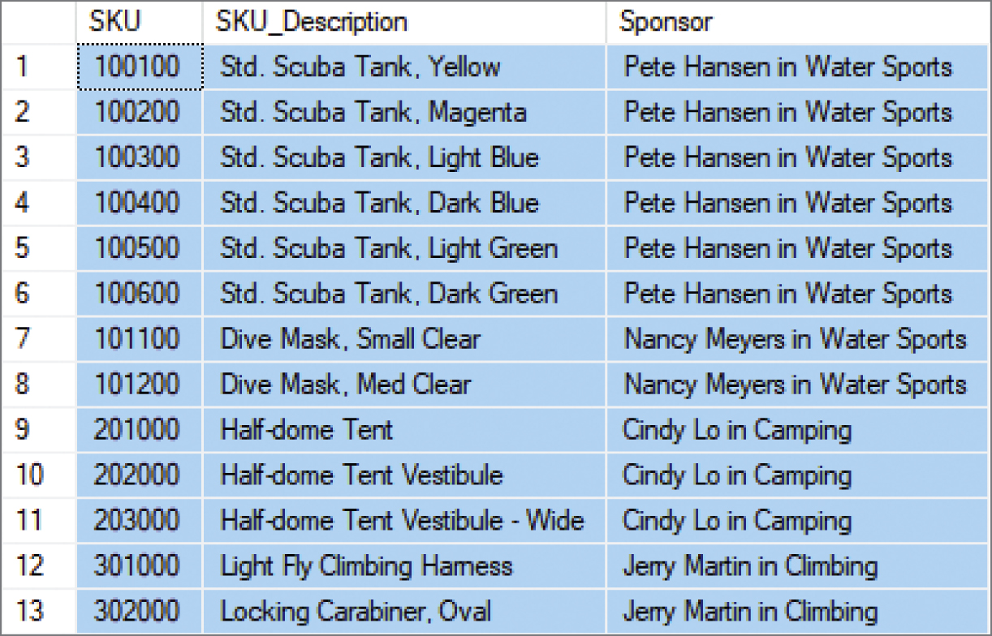
Performing Calculations in SQL Queries Using SQL Expressions with String Functions: Concatenation
SELECT SKU, SKU_Description, RTRIM(Buyer)+' in ‘ +RTRIM(Department) AS Sponsor
FROM SKU_DATA
ORDER BY SKU;

Slide 30
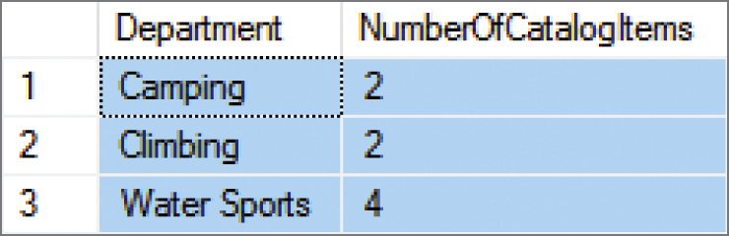
Grouping Rows in SQL Queries The SQL GROUP BY Clause
SELECT Department, COUNT(SKU) AS NumberOfCatalogItems
FROM CATALOG_SKU_2017
WHERE CatalogPage IS NOT NULL
GROUP BY Department;

Slide 31
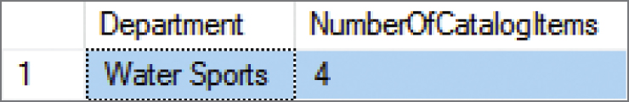
Grouping Rows in SQL Queries The SQL HAVING Clause
SELECT Department, COUNT(SKU) AS NumberOfCatalogItems
FROM CATALOG_SKU_2017
WHERE CatalogPage IS NOT NULL
GROUP BY Department
HAVING COUNT(SKU) > 2;

Slide 32
Grouping Rows in SQL Queries
The SQL WHERE clause specifies which rows will be used to determine the groups.
The SQL HAVING clause specifies which groups will be used in the final result.
In general, place WHERE before GROUP BY. Some DBMS products do not require that placement; but to be safe, always put WHERE before GROUP BY.
There is an ambiguity in statements that include both WHERE and HAVING clauses. The results can vary, so to eliminate this ambiguity SQL always applies WHERE before HAVING.

Slide 33
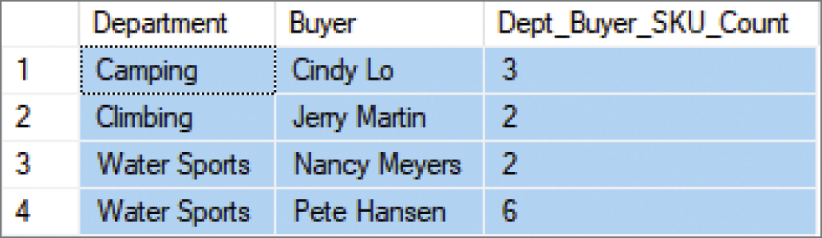
Grouping Rows in SQL Queries Grouping by More Than One Column
SELECT Department, Buyer, COUNT(SKU) AS Dept_Buyer_SKU_Count
FROM SKU_DATA
GROUP BY Department, Buyer;

Slide 34
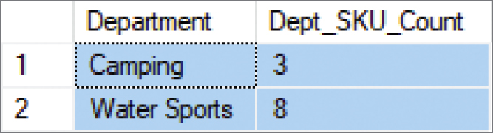
Grouping Rows in SQL Queries Using the SQL ORDER BY Clause with Groupings
SELECT Department, COUNT(SKU) AS Dept_SKU_Count
FROM SKU_DATA
WHERE SKU <> 302000
GROUP BY Department
HAVING COUNT(SKU) > 1
ORDER BY Dept_SKU_Count;

Slide 35
Database Processing Fundamentals, Design, and Implementation (15th Edition)
End of Presentation:
Week #3
Part 1B

